Slide 1

GUESSING GAME
Prepared By:
Amara Khan (359)
Abdul Ahad (349)
Ahmad Ali (340)

Slide 2
Scenario
The program will ask the user to guess a number between 1 and 255 without displaying it on the screen.
The user will then input the guessing number (It should be between 1 and 255 ).
The program will show the result of the guessing whether the number is less, more , error or right guess.

Slide 3
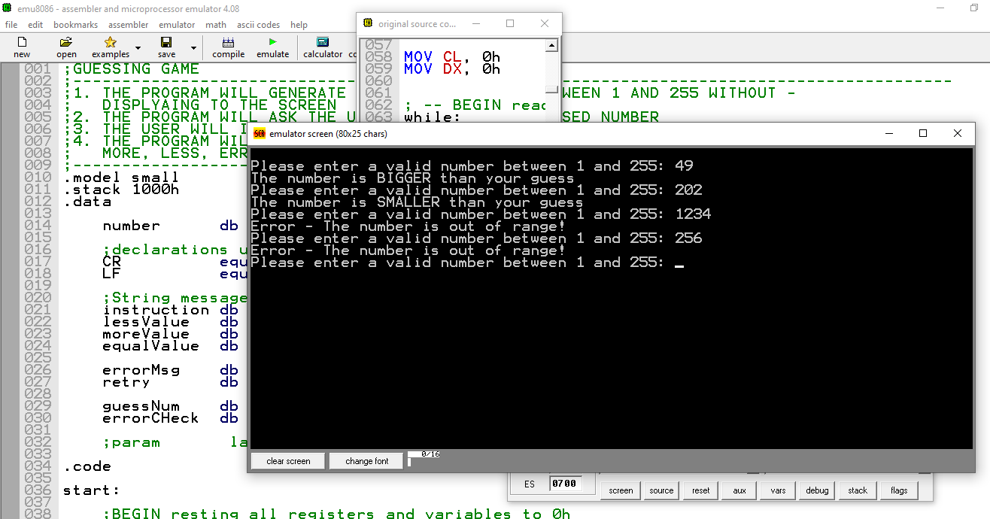
Here is an Example

Slide 4
Running
If the input number is less than guess number show ” the no is bigger than your guess ”.
If the input number is larger than guess number show ” the no is smaller than your guess ”.

Slide 5
Running
If the input number greater than 255 or less than 1 show ” out of range no ”.
If the input number more than 3 digits show ” out of range no ”.
If the input number is equal to the guessing no show “ you have made fine guess ”.

Slide 6
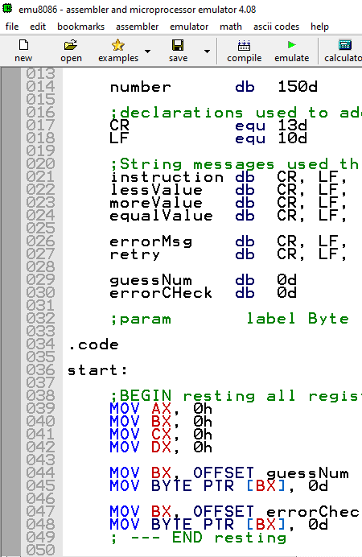
Working Procedure
Step 1- Take input from user.
Step 2- Check whether the input is not more than 3 digits.
Step 3- Also check that input is between 1 and 255.

Slide 7
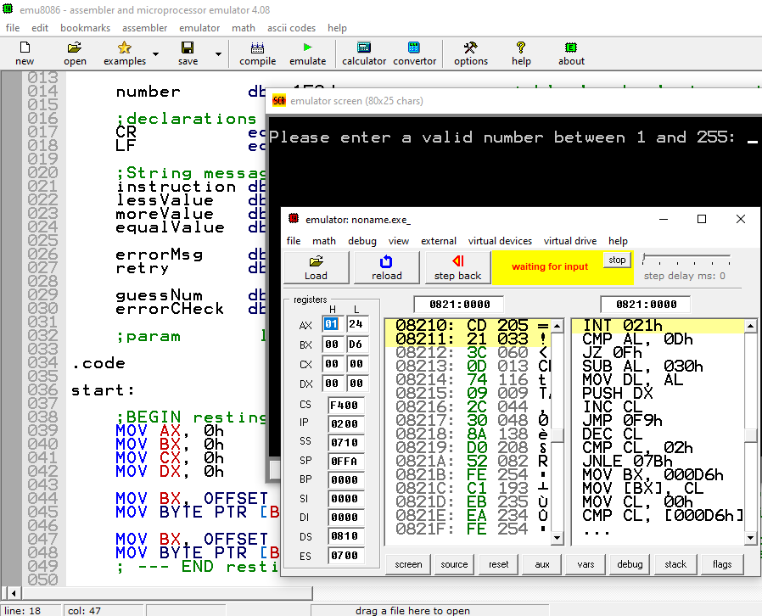
Working Procedure
Step 4- Compare the input with the guess value and display message respectively.
Step 5- If guessed ask user to play again (y/n) which means jump to start or jump to end.

Slide 8

THANK YOU

